Slide 1

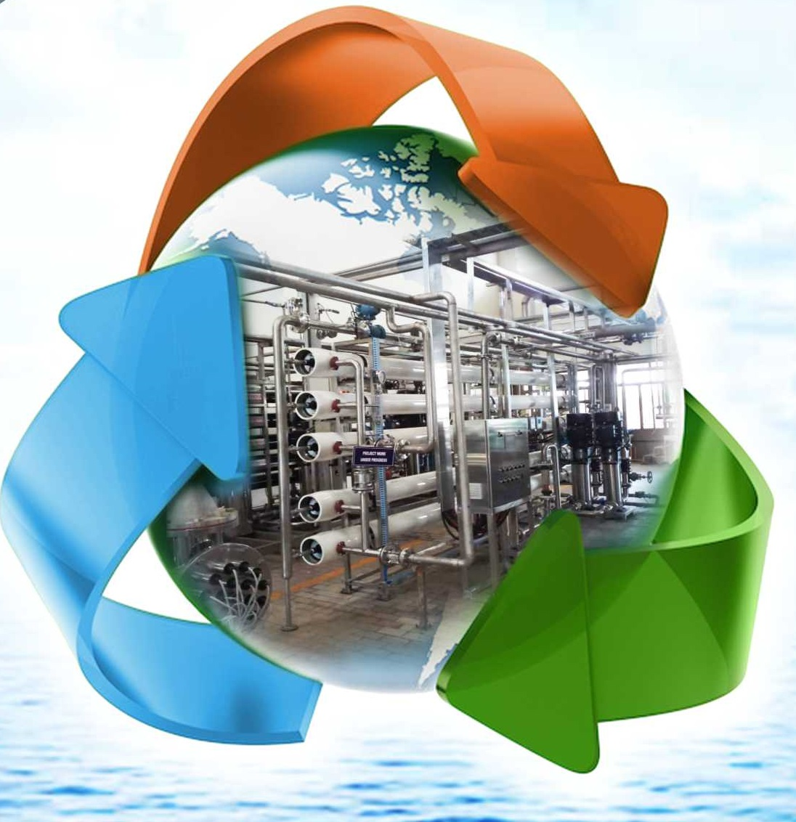
SHREE SAI WATER SERVICES
WASTE RECYCLE REUSE

Slide 2
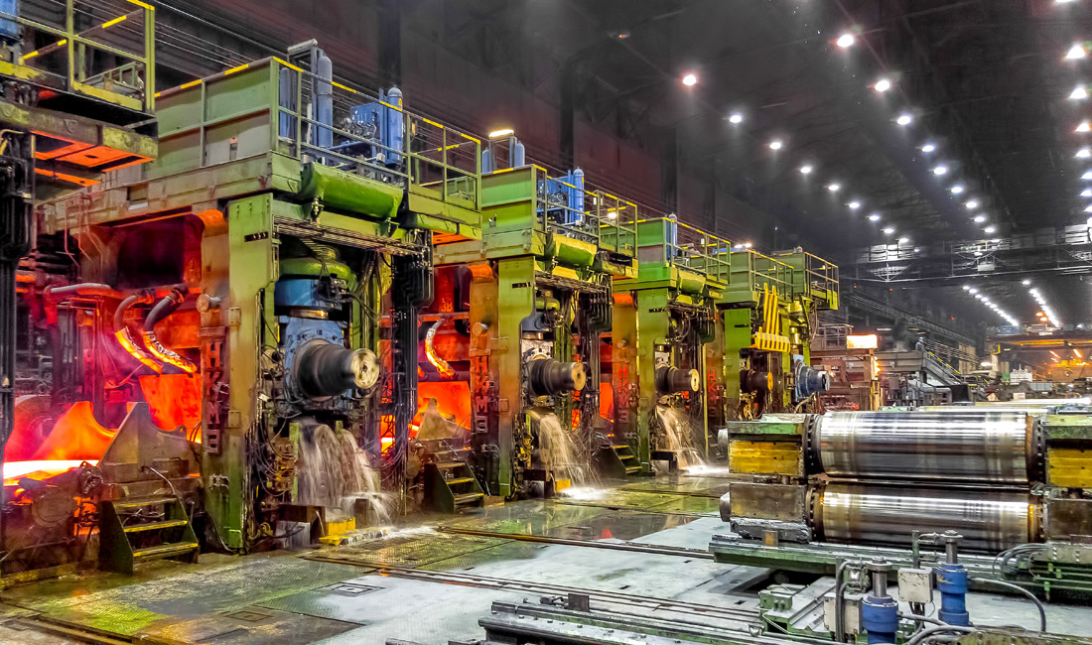
PRESENTATION ON
STEEL ROLLING MILL INDUSTRY WATER RECYCLE PLANT

Slide 3
PROCESS AND WATER USES
PROBLEM FACED BY ROLLING MILL
ADVANTAGES AFTER TREATMENT
TREATMENT UNIT DESCRIPTION

Slide 4
WATER USES IN STEEL INDUSTRY
Most of the water used in a steel plant is for cooling. Examples are coke quenching, cooling of blast furnace shell, oxygen lance in converter, cooling in continuous casting machines and hot rolling mills. Virtually any hot spot is cooled mainly by using water, one way or another.
Water is used for cleaning off-gas, in coke ovens, blast furnaces, and basic oxygen furnace etc.
Water is used for descaling in continuous casting and in hot rolling operations. It is also used as conveying media for transporting scales to the scale pit.
Water is used for on line heat treatment (thermo mechanical treatment) in the hot rolling mills.
Water is also used as part of chemical treatments, such as solvent in acidic pickling, matrix for generation of emulsions for rolling, cleaning, degreasing or rinsing steel sheet surface, etc.
Water is used for electrochemical treatments, such as electro-galvanizing or tin plating etc.

Slide 5
PROBLEM FACED BY MILL BEFORE INSTALLING TREATMENT PLANT
All processed water were going in drain and there is no way to use the same.
TMT Bar rusting & lost of shining issues were observed
Roll or Pass life decreased by using same untreated water
Frequent Pump maintenance issues were there which in terms increases maintenance cost.
Because of frequent maintenance issues plant need to shut down which in terms decreases production capacity

Slide 6
ADVANTAGES AFTER INSTALLING TREATMENT PLANT
The shining of the product improved and continue upto 15 days than regular water.
The maintenance of all pumps and pipe line will get reduce to 80%
Roller Pass life get increased by 30%
Water losses are decreased as blow down frequency increased
Cooling tower life is increased, scaling and fouling of Cooling tower decreased, overall efficiency of CT will increase.

Slide 7
WATER RECIRCULATION PLANT
Water generated from various process can be used after proper treatment
Recycle Treatment plant include Primary Clarifier and filtration which remove Oil, Grease and suspended particles from water and make water suitable for process like Quenching, Cooling of Rolling mills.

Slide 8
PROCESS UNITS IN TREATMENT PLANT
Collection tank– It is provided to collect all waste water through under drain.
Clarifier – Clarifier is provided to remove Suspended particles and oil & grease from water.
Filtration – Filtration is used to remove suspended particles from water escaped from clarifier

Slide 9
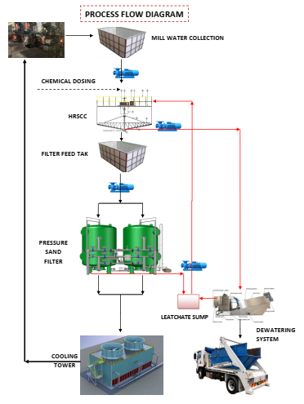
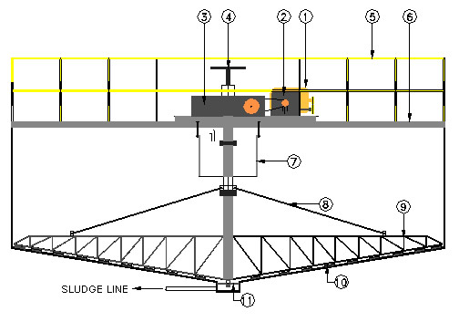
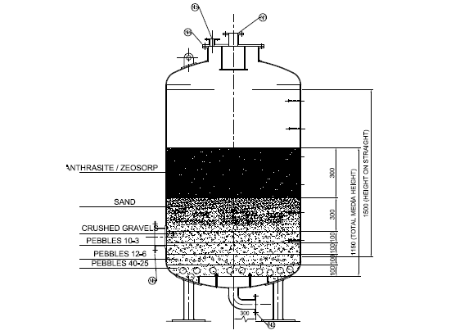
TYPICAL PROCESS FLOW DIAGRAM FOR RECIRCULATION PLANT

Slide 10
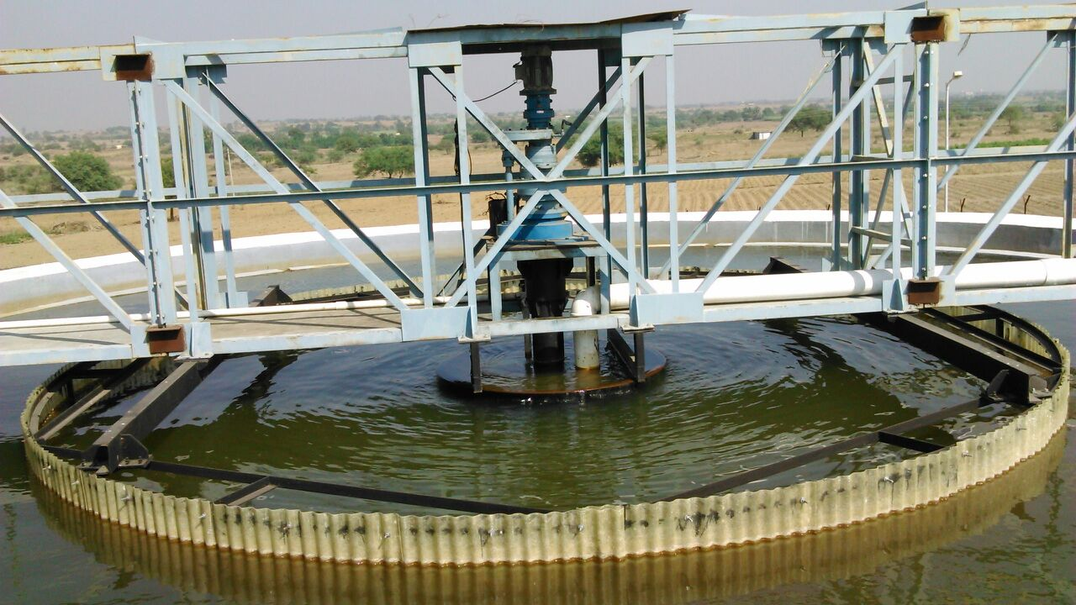
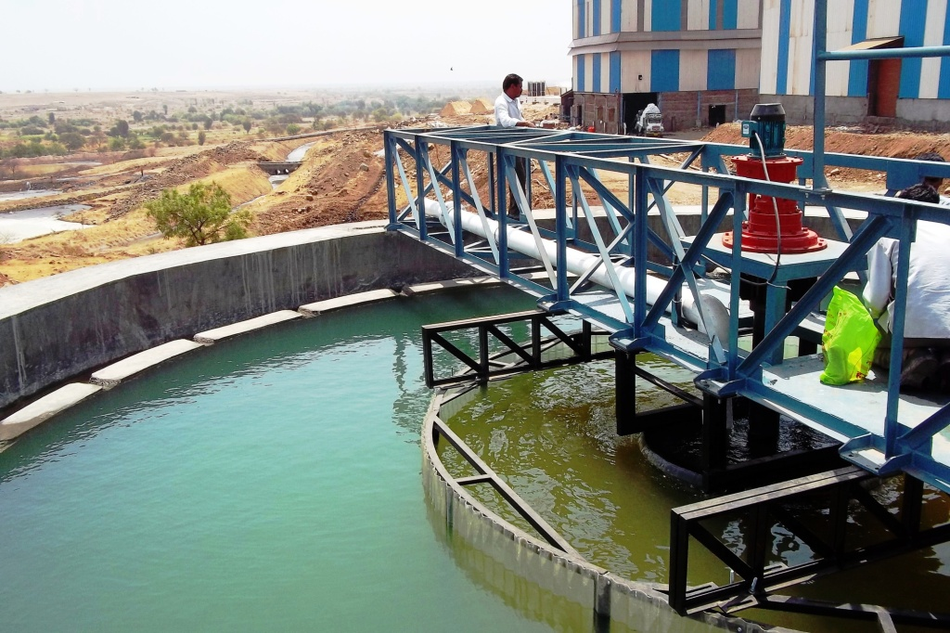
CLARIFIER

Slide 11
Working Principle
HRSCC mainly working on two basic principle i.e. coagulation, flocculation and hydraulic separation.
Coagulation and flocculation occurs in flocculation zone by using chemicals
The clarifier has been designed such that coagulation, flocculation, setting and sludge remove are combined in a single tank.
Remove suspended particles efficiently.
HRSCC are mainly designed on Rise rate.

Slide 12
FILTRATION
A typical filter consists of a pressure vessel-this could be either vertical or horizontal-fitted with a set of frontal pipe work and valves, graded sand supported by layers of graded under bed consisting of pebbles and Sand, a top distributor to distribute the incoming water uniformly throughout the cross section of the filter, and an under drain system to collect filtered water.

Slide 13
Working Principle
In pressure sand filter raw water flows down through the filter bed and as the suspended matter is retained on the sand surface.
There is flow reduction once the pressure drop across the filter is excessive. The filter is now taken out of service and cleaning of the filter is effected by flow reversal.
To assist in cleaning the bed, the backwash operation is often preceded by air agitation through the under drain system.
The process of air scouring agitates the sand with a scrubbing action, which loosen the intercepted particles.
The filter is now ready to be put back into service.

Slide 14
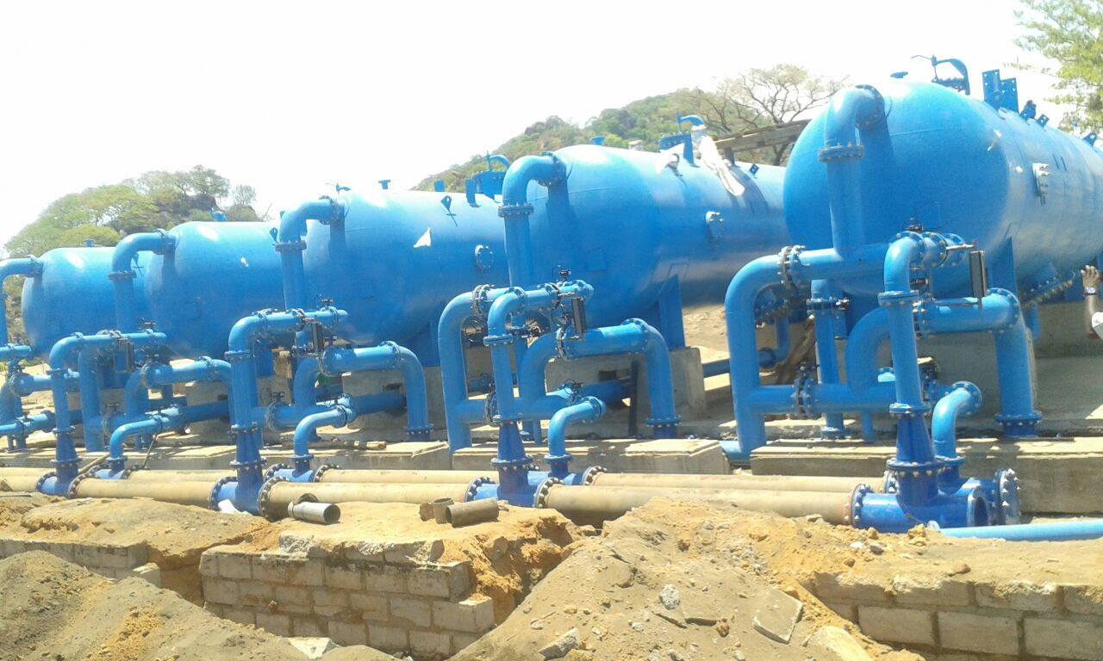
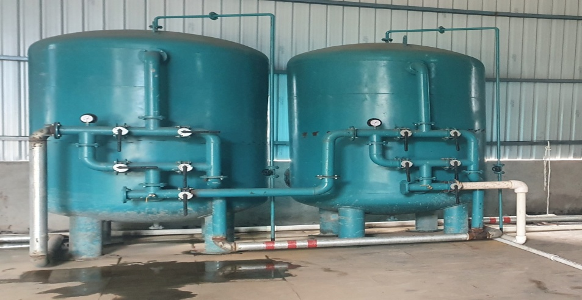
PRESSURE SAND FILTER

Slide 15
SLUDGE MANAGEMENT
Sludge Generated from Clarifier will be collected in Tank and can further be processes to Sludge dewatering system like Sludge Thickener, Filter Press, Centrifuge, belt filter, volute screw press etc.

Slide 16
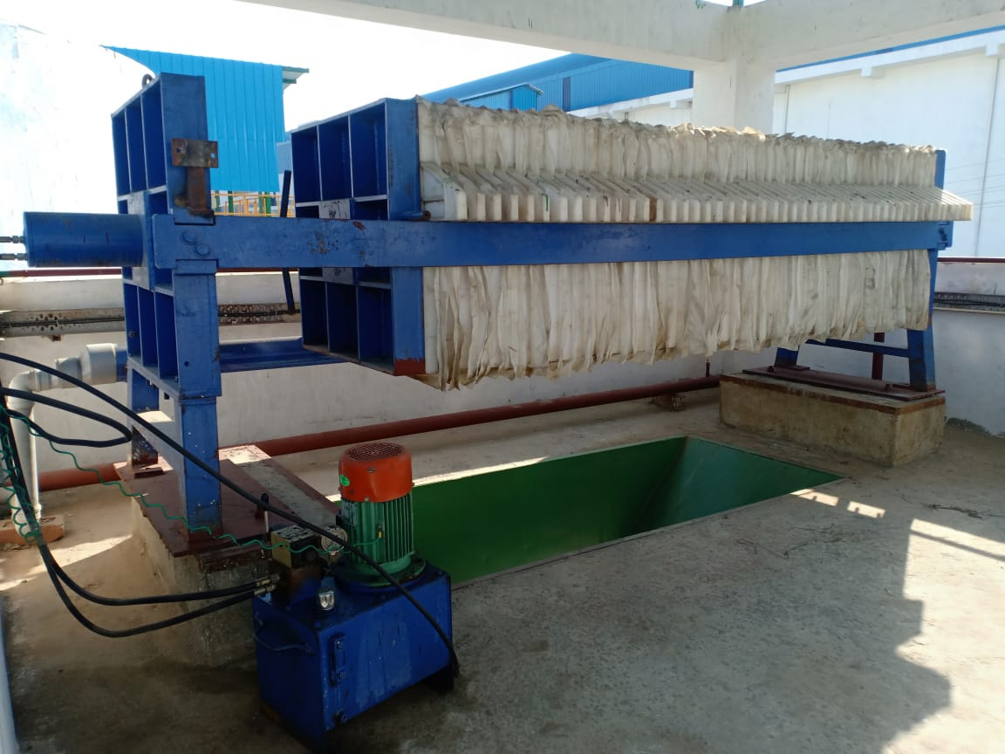
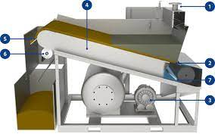
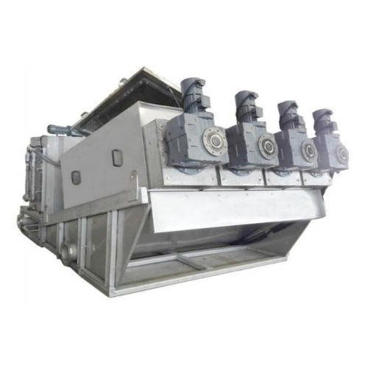
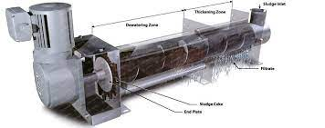
TYPICAL SLUDGE DEWATERING SYSTEM

Slide 17
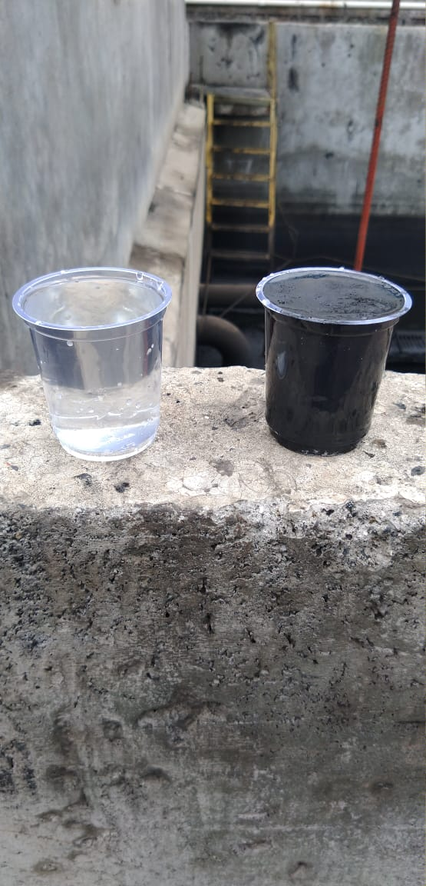
WATER QUALITY BEFORE AND AFTER

Slide 18
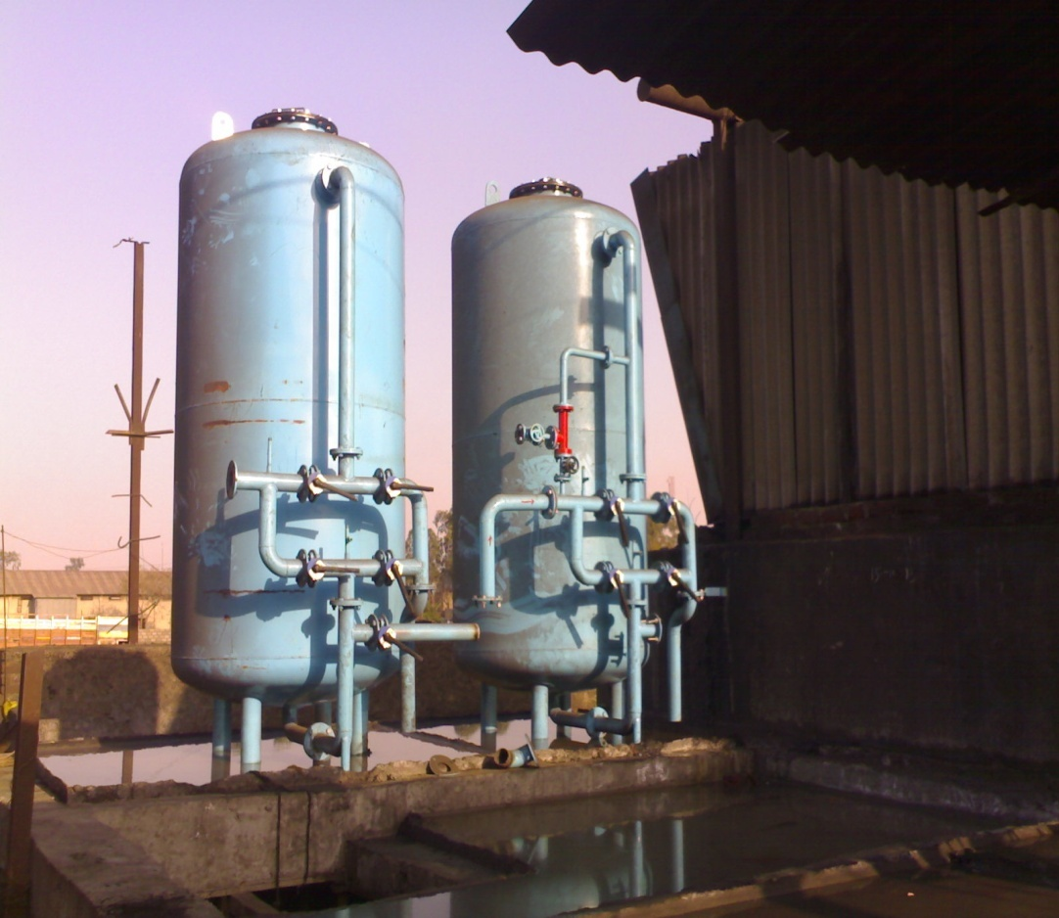
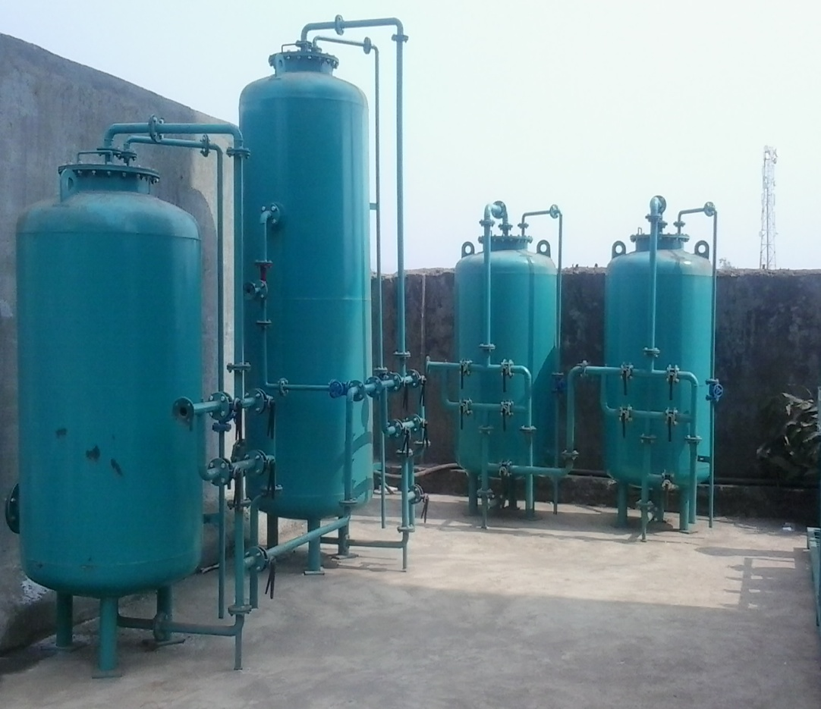
OUR INSTALLATION
AT BHAGYALAXMI STEEL- @ 1500 M3/hr AT GEETAI STEEL - @ 1080 m3/Hr

Slide 19

SHREE SAI WATER SERVICES

